Slide 1
Wine Quality
By Anthony Lupo

Slide 2
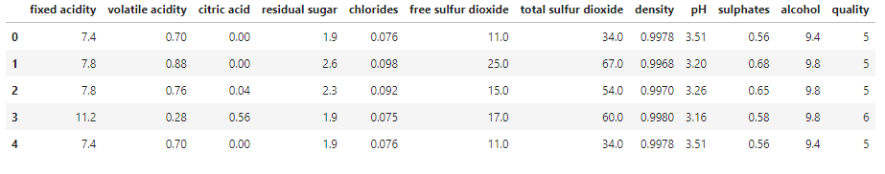
About the Dataset
wine.head()
This dataset is not my dataset, but is from a kaggle competition. The competition states:
“This datasets is related to red variants of the Portuguese "Vinho Verde" wine. For more details, consult the reference [Cortez et al., 2009]. Due to privacy and logistic issues, only physicochemical (inputs) and sensory (the output) variables are available (e.g. there is no data about grape types, wine brand, wine selling price, etc.).”

Slide 3
What is the target?
Target = The Quality of the wine.
The goal of this project is to be able to create an algorithm that is able to correctly predict the quality of the wine, based off of the 11 features that are given to us.

Slide 4
Steps
Identify the target of the data
Identify the type of problem this is going to be.
Regression or Classification
Clean the data
Check for Duplicates
Check for missing values
Check for an irregularities in the numerical Columns (which is all of them)
Next Split the DataFrame into a target and Features
Create Univariate Visuals for the target and Features
Boxplots, Histograms
Create Multivariate Visuals for the Target vs. the Features
Barcharts
Explore Correlations
Heatmaps, Scatterplots

Slide 5
Identify the target
The Quality of the Wine is what I am trying to figure out. So the ‘quality’ column is the target.

Slide 6
What Type of Problem Will this Be?
The quality column is numerical, so we are going to be using Regression problems.

Slide 7
Clean the Data
Check for Duplicates
wine.duplicated.sum()
240 duplicates
What to do with the duplicates?
Drop them!!

Slide 8
Clean the Data
Check for Missing Values
wine.isnull().sum()
0
There is no missing data, so there is nothing further to do here.

Slide 9
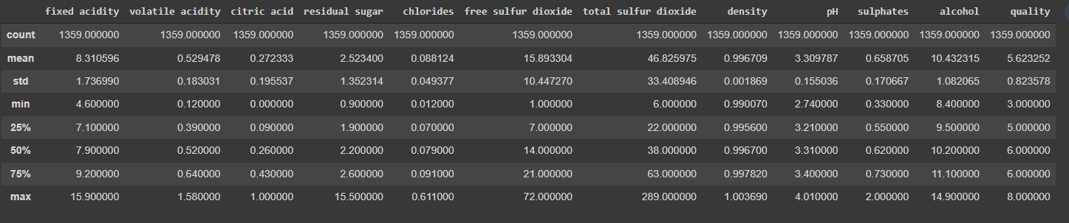
Clean the Data
Check for irregularities in numerical columns.
wine.describe()
No irregularities: proceed to next step

Slide 10
Split the DataFrame into Target and Features:
y is our target:
y = wine[‘quality’]
X is the features
X = wine.drop[columns = ‘quality’]
Now that the split is done, let’s take a look at some visualizations of our data.

Slide 11
Univariate Visualizations:
Histograms and Boxplots
Make a for loop to create a histogram and boxplot of all of our data
number_columns = wine.select_dtypes('number').columns
for col in number_columns:
wine.hist(column = col, bins=20)
plt.show()
wine.boxplot(column = col)
plt.show()
With histograms and boxplots we can see how our features are skewed and which ones contain outliers.

Slide 12
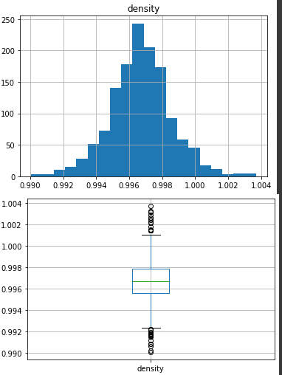
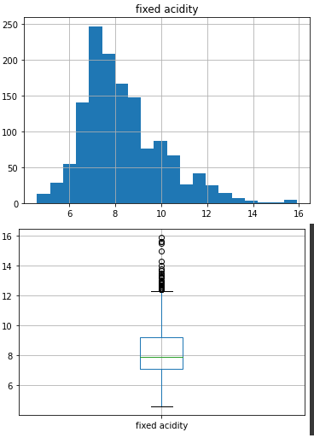
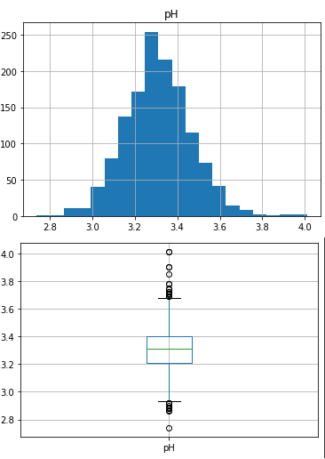
Histograms and Boxplots continued:

Slide 13
Create Multivariate Visuals:
Target vs. Features
Create another for loop and show the different features (y-axis) compared to the target (x-axis)
These are bargraphs
for feature in wine:
fig = plt.figure(figsize=(5,5))
sns.barplot(x = wine['quality'], y = feature , data = wine)
plt.show()

Slide 14
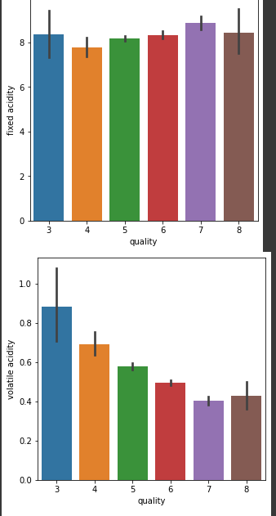
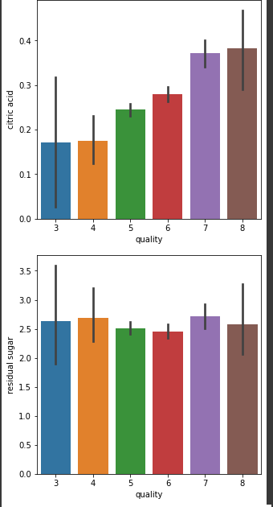
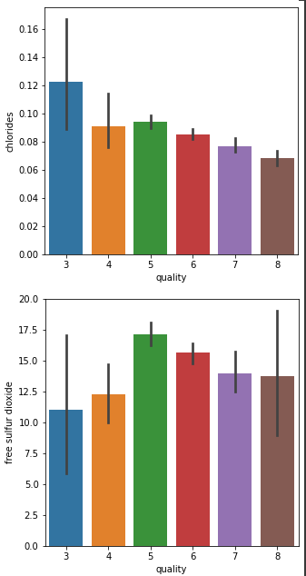
Create Multivariate Visuals: continued

Slide 15
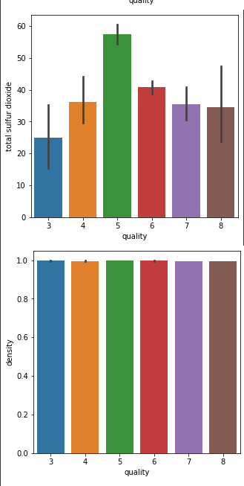
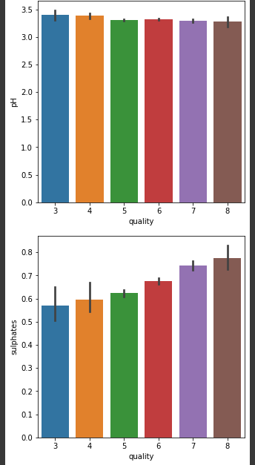
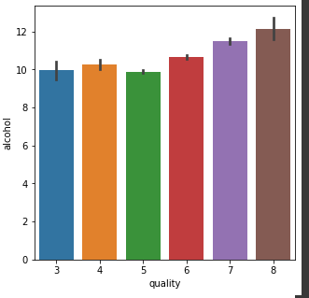
Create Multivariate Visuals: continued

Slide 16
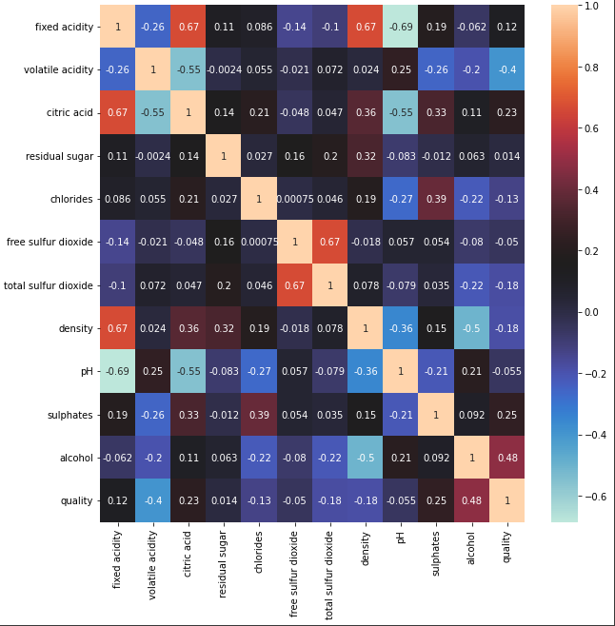
Explore Correlations:
Heatmaps
winecorr = wine.corr()
plt.figure(figsize=(10,10))
sns.heatmap(winecorr, cmap='icefire', annot=True);
There seems to be a strong correlation between:
- density and fixed acidity (0.67)
- citric acid and fixed acidity (0.67)
- pH and fixed acidity (-0.69) (negative Correlation)

Slide 17
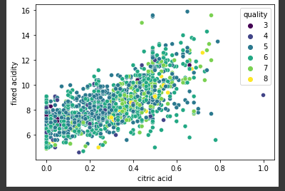
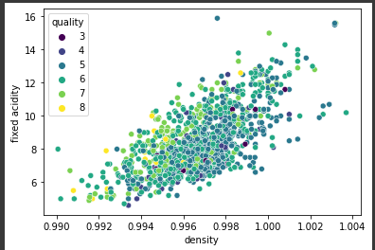
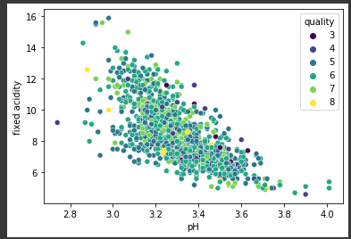
Explore Correlations:
Scatter Plots
sns.scatterplot(data=wine, x = 'density', y = 'fixed acidity', hue = 'quality', palette ='viridis' );
sns.scatterplot(data=wine, x = 'pH', y = 'fixed acidity', hue = 'quality', palette = 'viridis' );
sns.scatterplot(data=wine, x = 'citric acid', y = 'fixed acidity', hue = 'quality', palette = 'viridis');
1) 2) 3)

